Slide 1
Univariate Analysis and Transforming Data
Business Intelligence Systems and Data Mining IMAT5168 Analytics Programming

Slide 2

Parametric Statistical Models
Dependent variable (DV):
Continuous
Independent variable (IV):
Categorical or continuous variable dividing DV into…
Models
One group t-test, z-test
Two independent groups t-test
Two dependent groups t-test on difference, $μ_{diff}$=0
3 or more groups one way ANOVA
Ordered groups ANOVA with linear trend
Infinite groups (continuous IV) regression

Slide 3
Non-parametric tests
What happens when the assumptions of parametric tests are violated?
The assumptions are usually that involved variables follow the normal distribution.
If data do not follow the normal distribution:
Attempt to transform the data so that the assumptions are met
If this cannot be done, consider using non-parametric tests…
SAS commands that perform non-parametric statistical tests:
proc univariate
proc npar1way
proc freq

Slide 4
Parametric vs non-parametric data
Parametric models
rely on assumptions about (transformed) data or residuals fitting the normal distribution
are more robust if the data has no outliers (values >3sd from the mean)
Non-parametric models
require larger samples to prevent false positive and false negative errors
i.e. have ‘less power’
but make fewer assumptions
i.e. are ‘more robust’
Choice of model depends on the data
Numeric data related to ranks, where ‘+1’ has no meaning should suggest the use of a non-parametric test
Or on evaluation of parametric test assumptions & the data cannot be transformed

Slide 5
Summarize the outcome variable
Standard histogram…
More control using ODS Graphics
proc univariate
data = nitrofen;
var total;
histogram
/ normal;
qqplot
/ normal
(mu=est
sigma=est);
run;
proc sgplot
data = nitrofen;
histogram total
/ nbins=36;
xaxis
values=
(0 to 40 by 2);
density total;
keylegend
/ location=outside
position=top;
run;

Slide 6
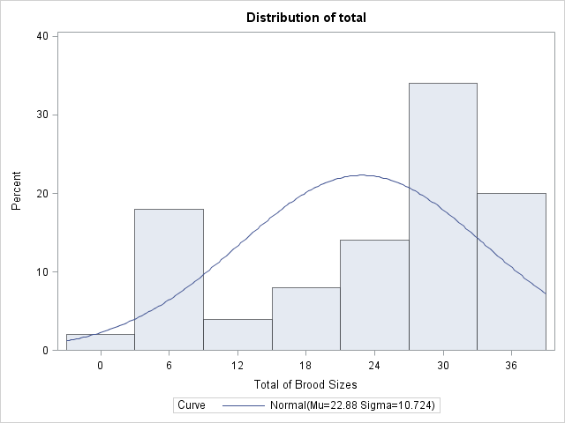
View the distribution with proc univariate

Slide 7
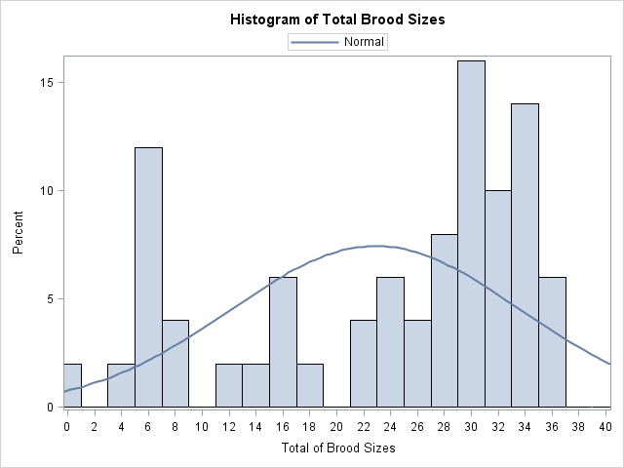
Or with proc sgplot

Slide 8
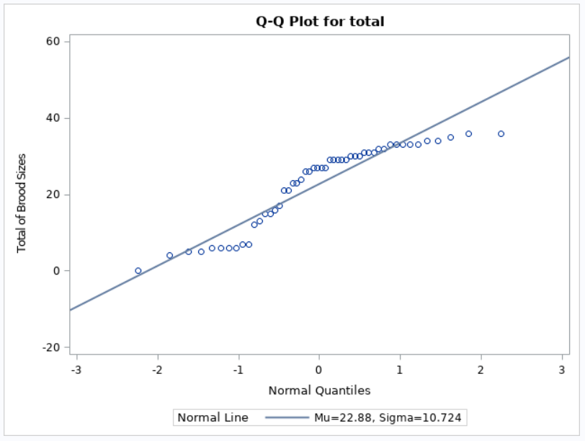
Testing for normality example: univariate qq-plot nitrofen data
See also Park HM, (2008) Univariate Analysis and Normality Test Using SAS, Stata and SPSS, http://www.indiana.edu/~statmath

Slide 9
Example transformation functions
log
Logarithm to base e
log10
Logarithm to base 10
sqrt
Square root
x**y
Raise X to the power y
Choosing what to use is dependant on your data and the statistical model you are using

Slide 10
Define your own functions…
options cmplib=(work.project);
proc fcmp outlib=work.project.lib;
function square(x);
return (x*x);
endsub;
function rs1px(x);
return ((1+x)**-2.5);
endsub;
function rc1px(x);
return ((1+x)**-3);
endsub;
run;
/* delete the functions when no longer needed */
proc fcmp outlib=work.project.lib;
deletefunc square;
deletefunc rs1px;
deletefunc rc1px;
run;

